Slide 1


Group-3 Capstone Project Shop-For-home
Presented by-
KOPPULA DEEPIKA
Poorvi SHRIVAS
Raj kumar
Shreya gangopadhyay
Sugandha Ravindra dhanawade

Slide 2
ABSTARCT
Furniture items, Shirts, Home appliances, etc.. ordering is a form of electronic commerce which allows customers to directly buy goods from a seller over the internet using a web browser. Customer can find a product based on type of categories and also by visiting the website and searching among alternative products using a shopping search functionalities, which displays the same products availability and pricing at different e-retailers. When an online store is set up to enable businesses to buy from another businesses, the process is called business- to-business (B2B) online shopping.

Slide 3
Introduction
ShopForHome is a popular Store in the market for shopping the home décor stuff. Due to Covid 19 all the offline shopping stopped. So, the store wants to move to the online platforms and wants their own web application.
There are 2 users on the application: -
1.User
2.Admin

Slide 4
Features
User Stories –
As a user I should be able to login, Logout and Register into the application.
As a user I should be able to see the products in different categories.
As a user I should be able to sort the products.
As a user I should be able to add the products into the shopping cart.
As a user I should be able to increase or decrease the quantity added in the cart.
As a user I should be able to add “n” number of products in the cart.
As a user I should be able to get the Wishlist option where I can add those products which I want but don’t want to order now.
As a user I should get different discount coupons.

Slide 5
Admin Stories –
1. As an Admin I should be able to login, Logout and Register into the application.
2. As an Admin I should be able to perform CRUD on Users.
3. As an Admin I should be able to Perform CRUD on the products.
4. As an Admin I should be able to get bulk upload option to upload a csv for products details
5. As an Admin I should be able to get the stocks.
6. As an Admin I should be able to mail if any stock is less than 10.
7. As an Admin I should be able to get the sales report of a specific duration.
8. As an Admin I should be able to set the discount coupons for the specific set of users

Slide 6
Technologies Used
Frontend –
AngularJS
Material UI
HTML,CSS
Bootstrap Grid
Font Awesome Icons
Backend –
Java
SpringBoot
Data JPA
Microservices
Database –
Mysql

Slide 7
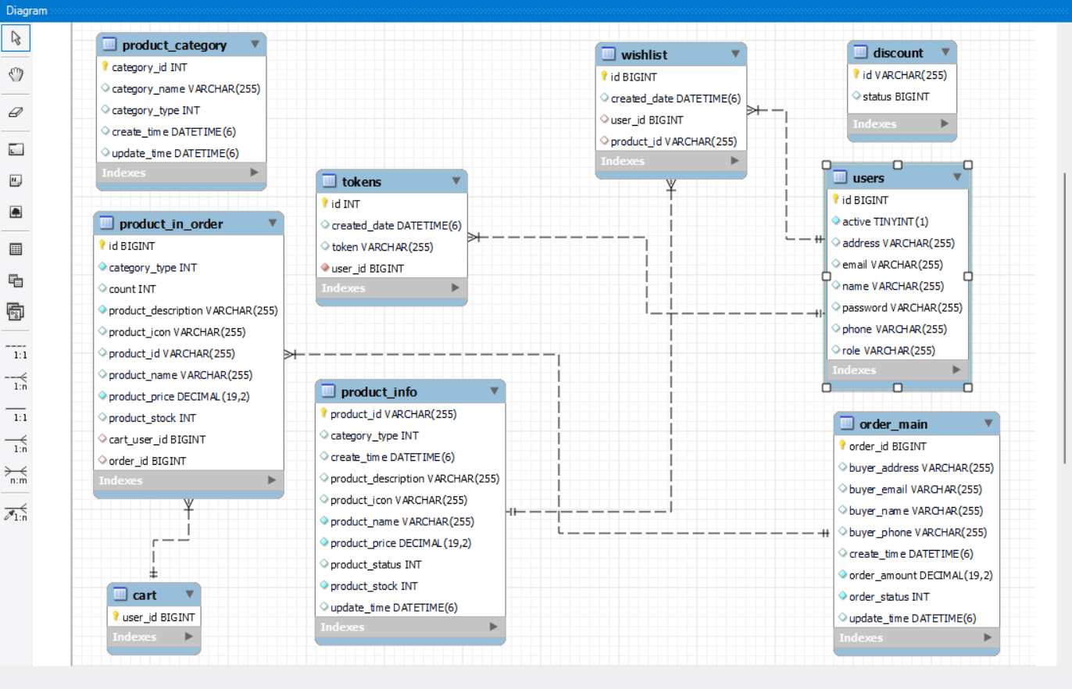
er diagram

Slide 8
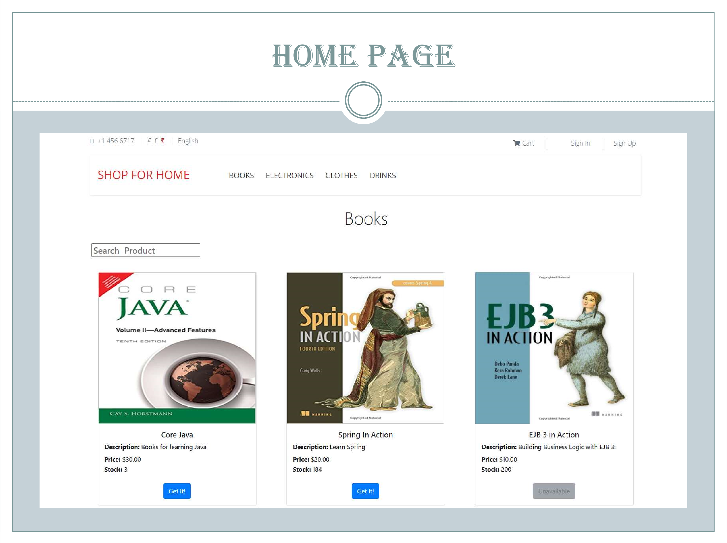
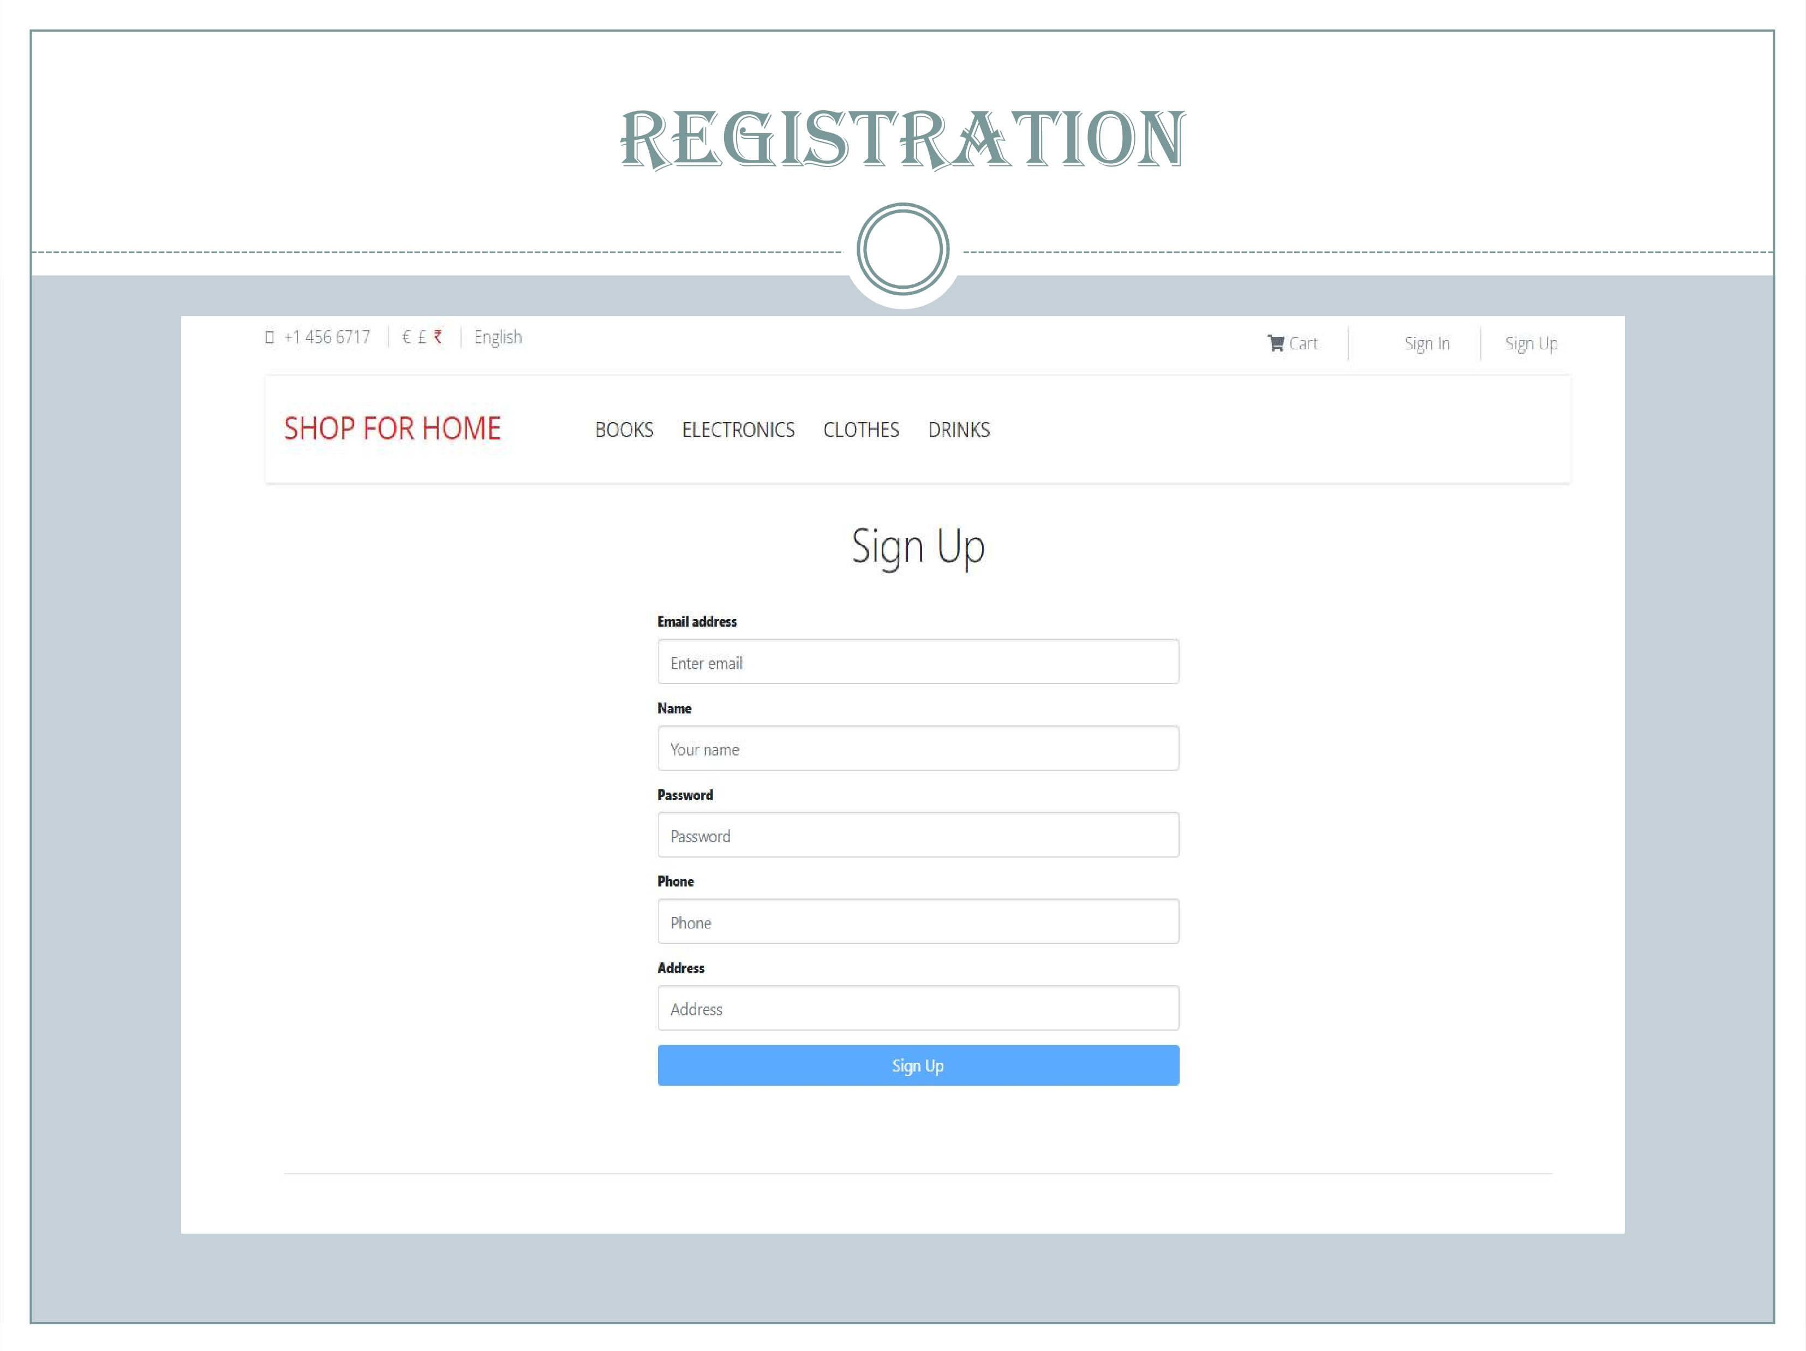
Screenshots of Project -

Slide 9
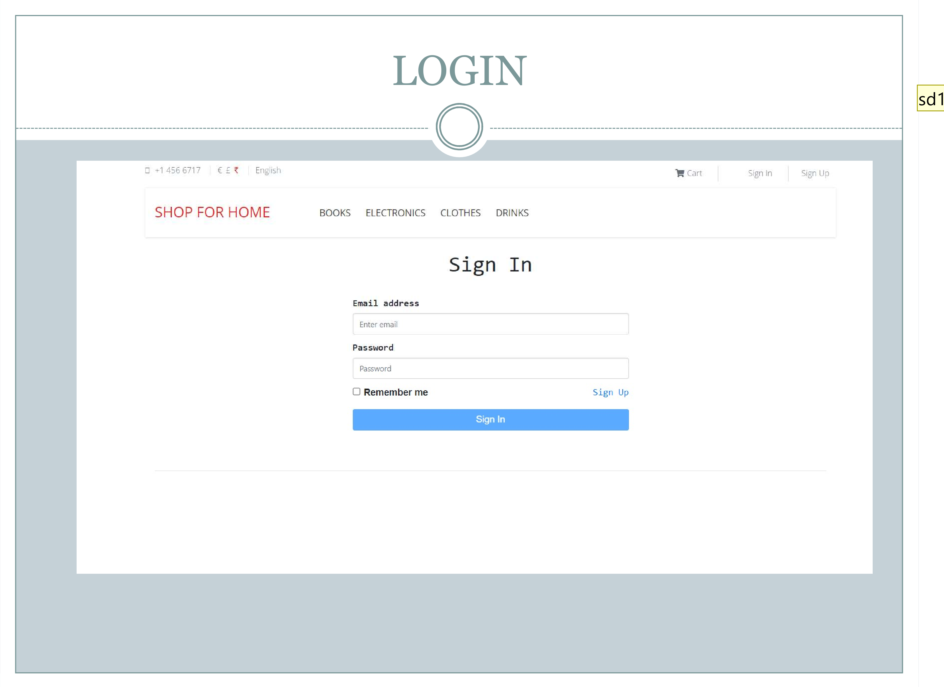
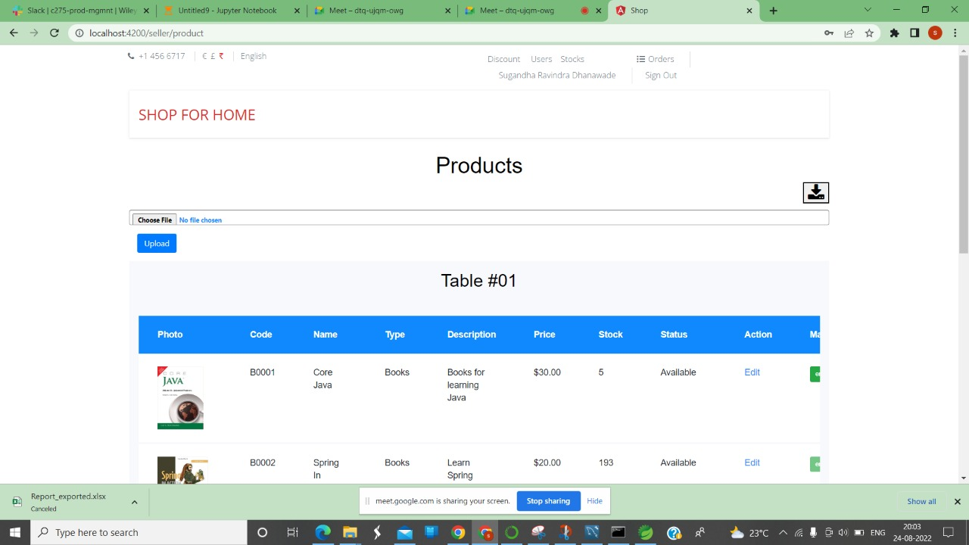

Slide 10
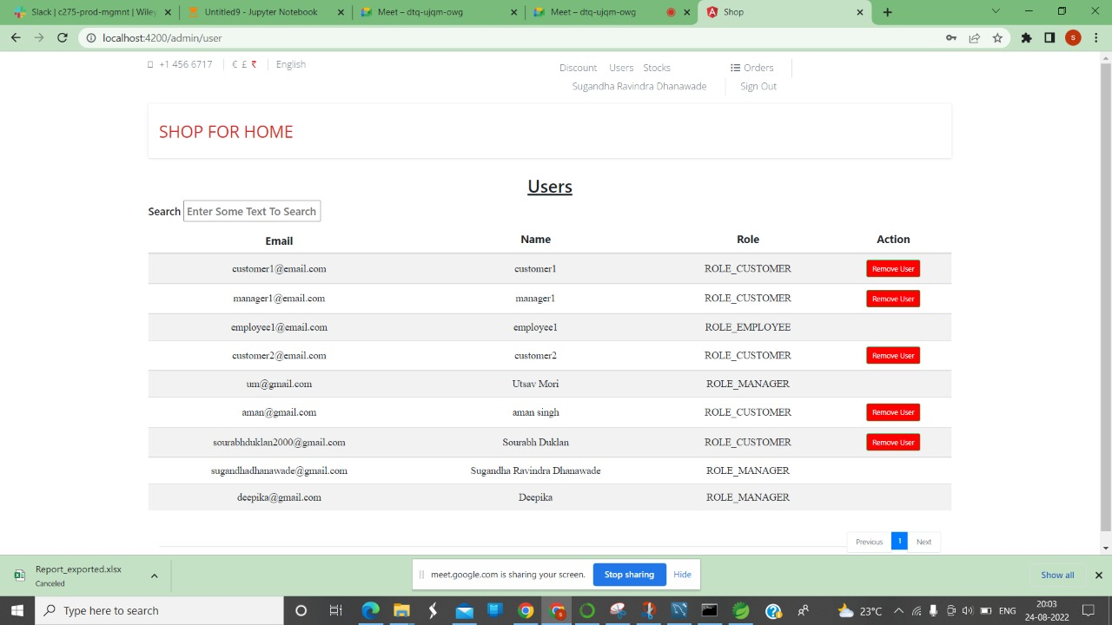
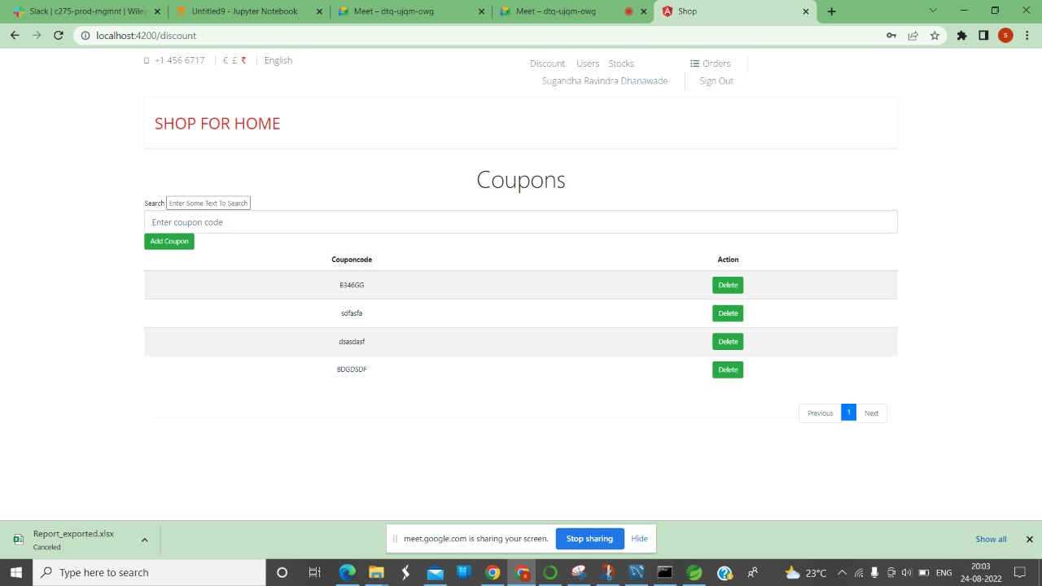

Slide 11
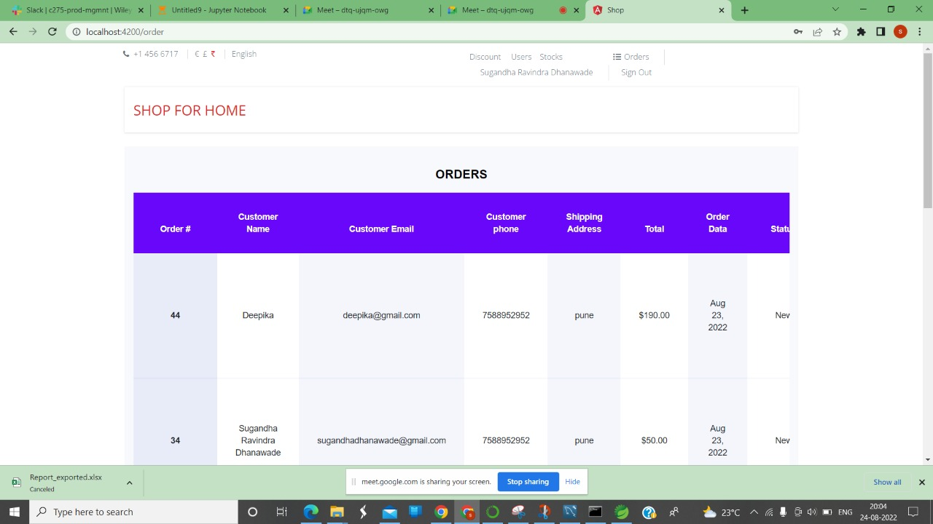
Order placed by user

Slide 12
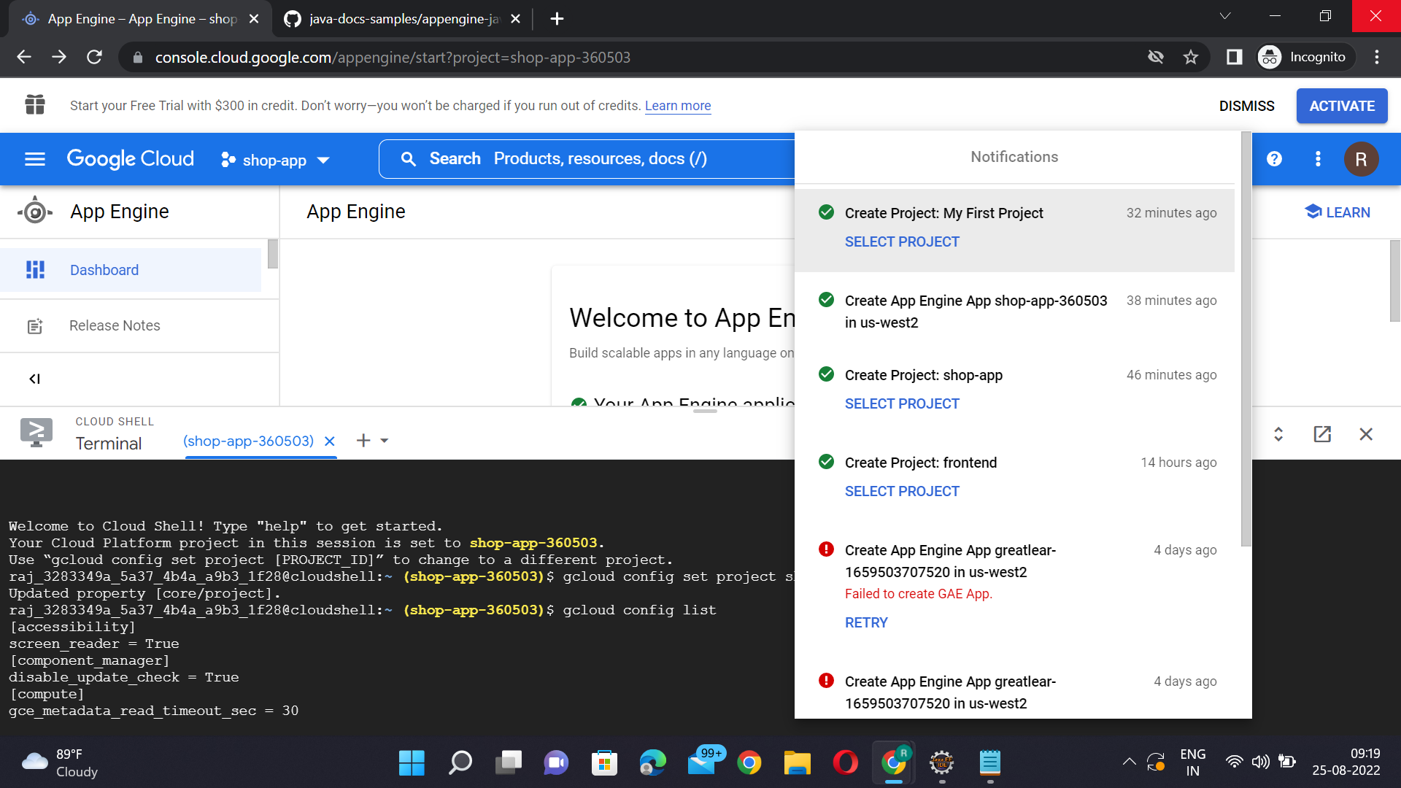
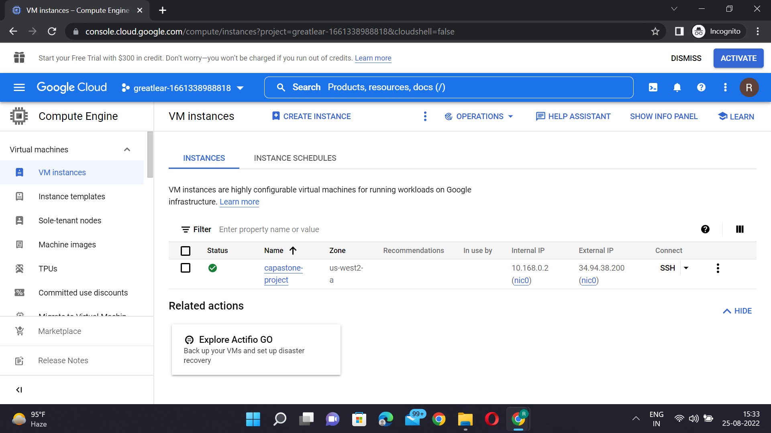
ScreeNshots of GCP DEPLOYMENT FRONTEND PART

Slide 13
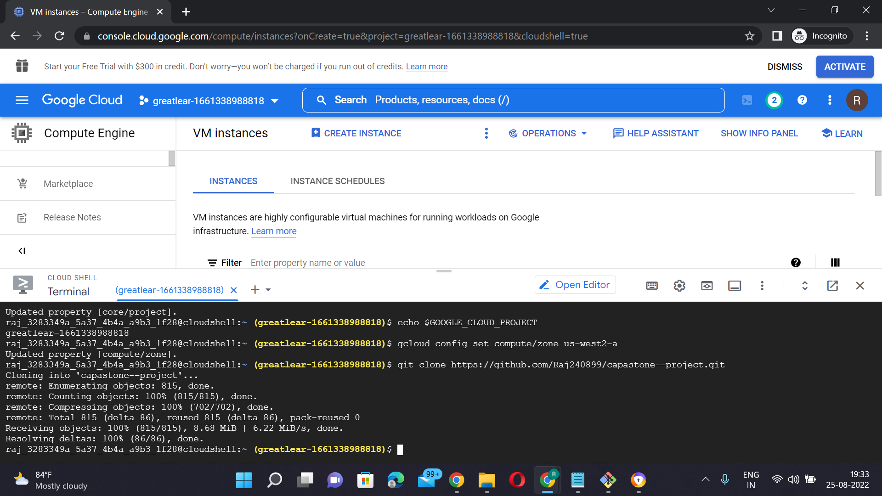
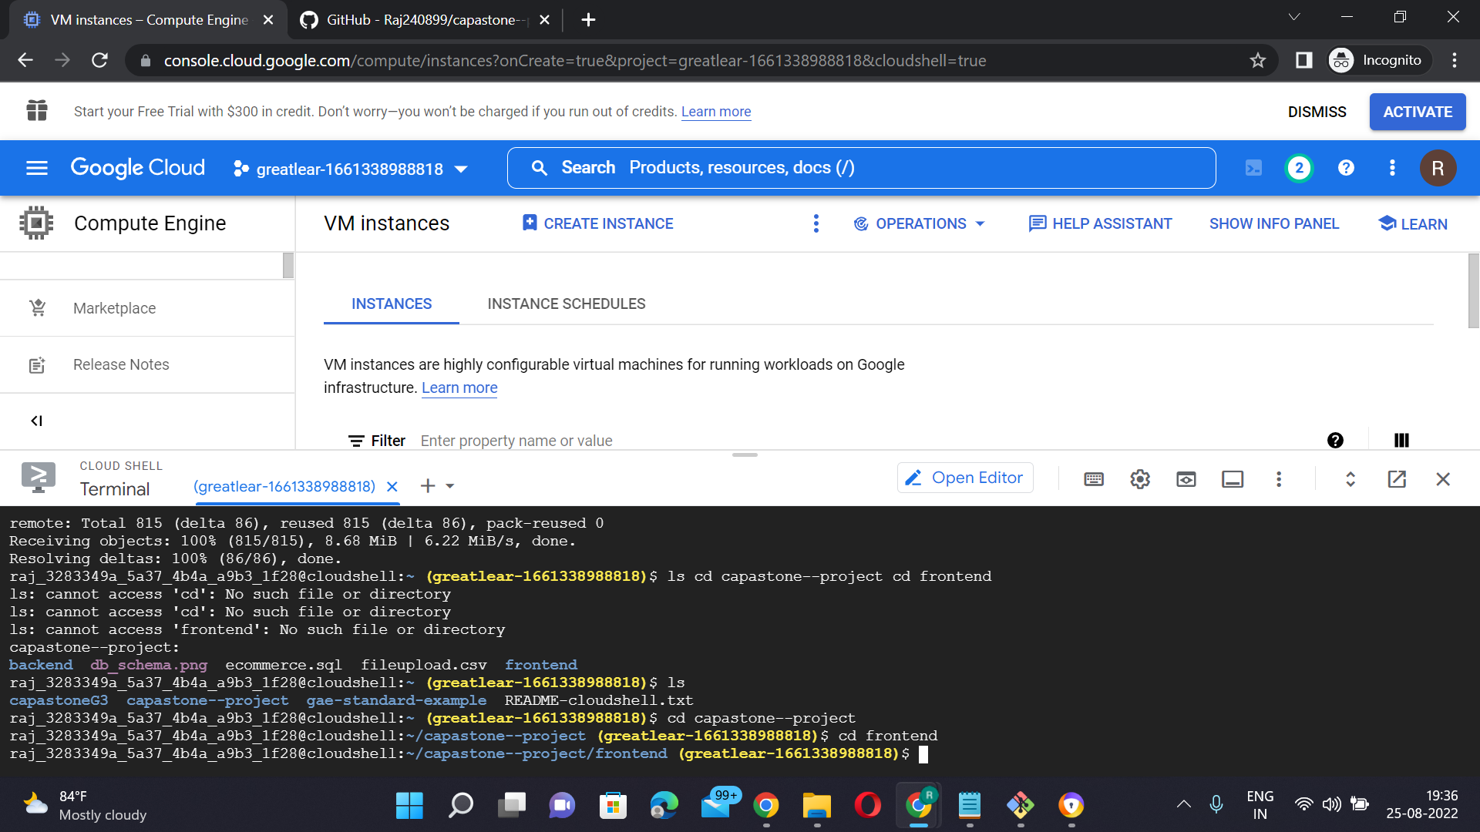

Slide 14
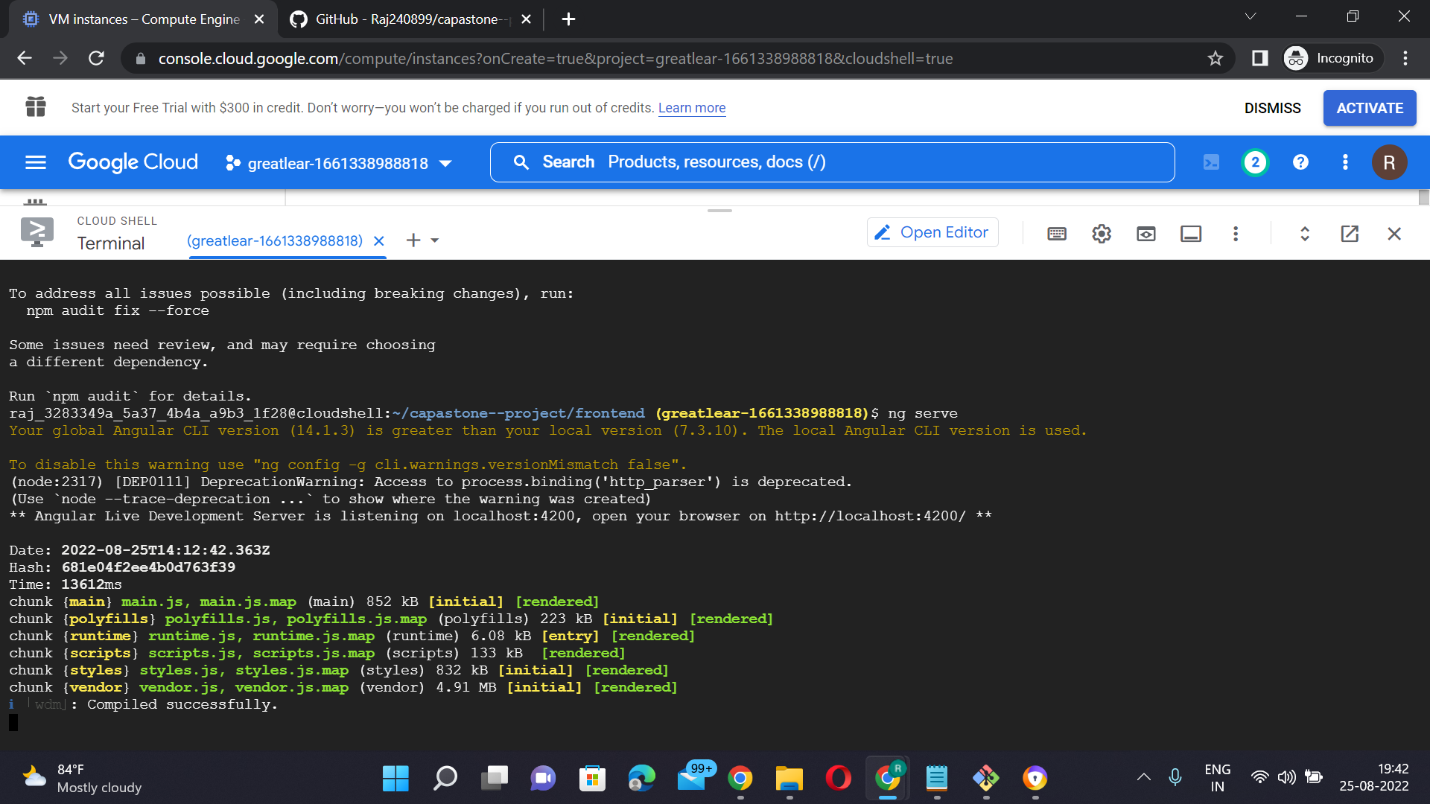

Slide 15
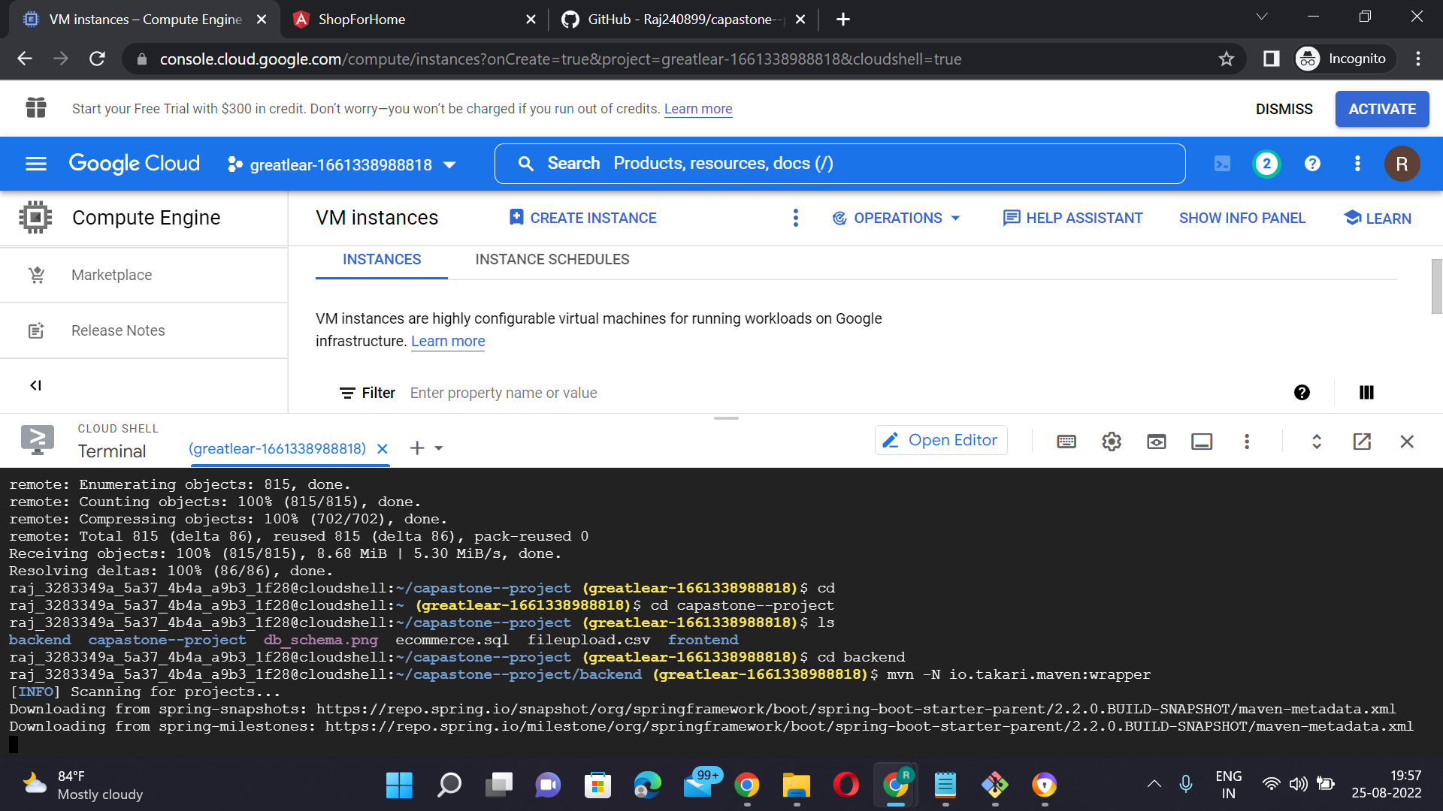
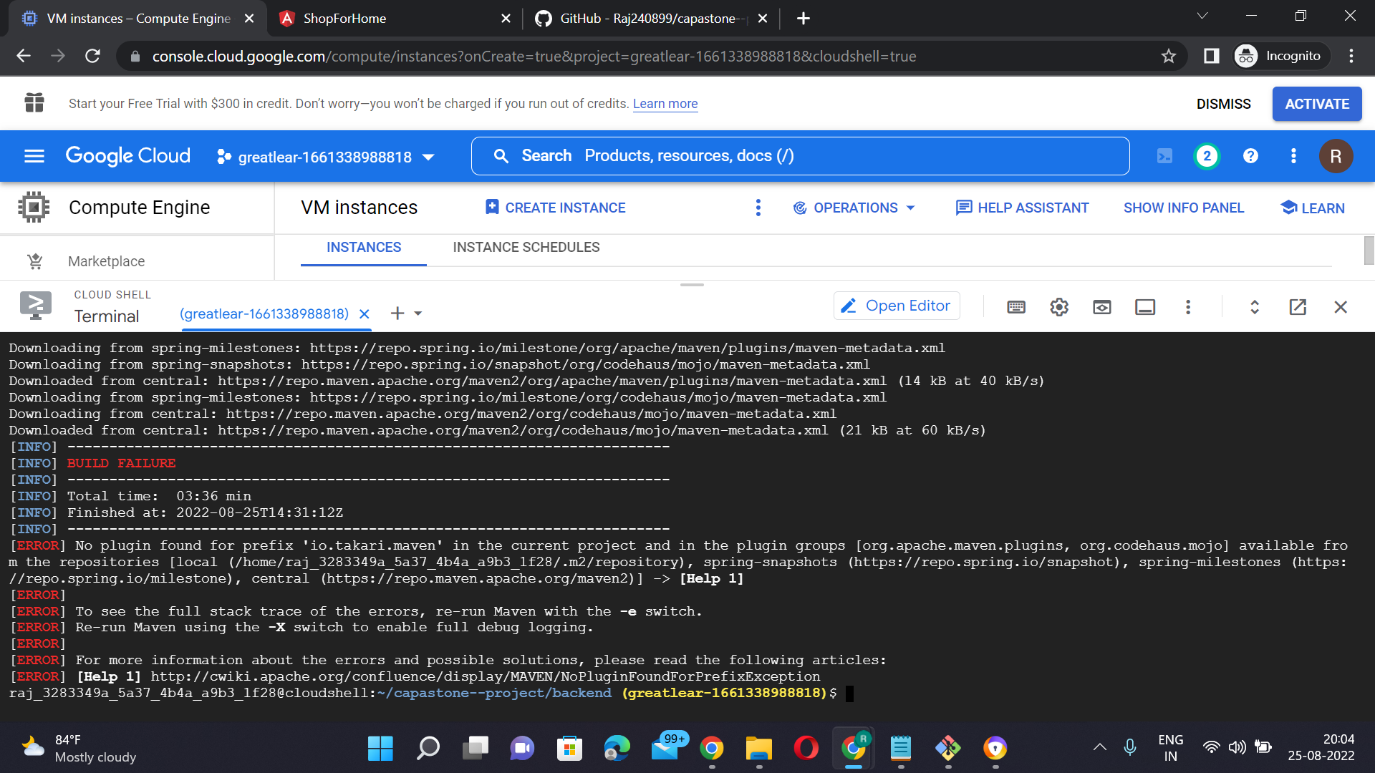
BACKEND PART

Slide 16
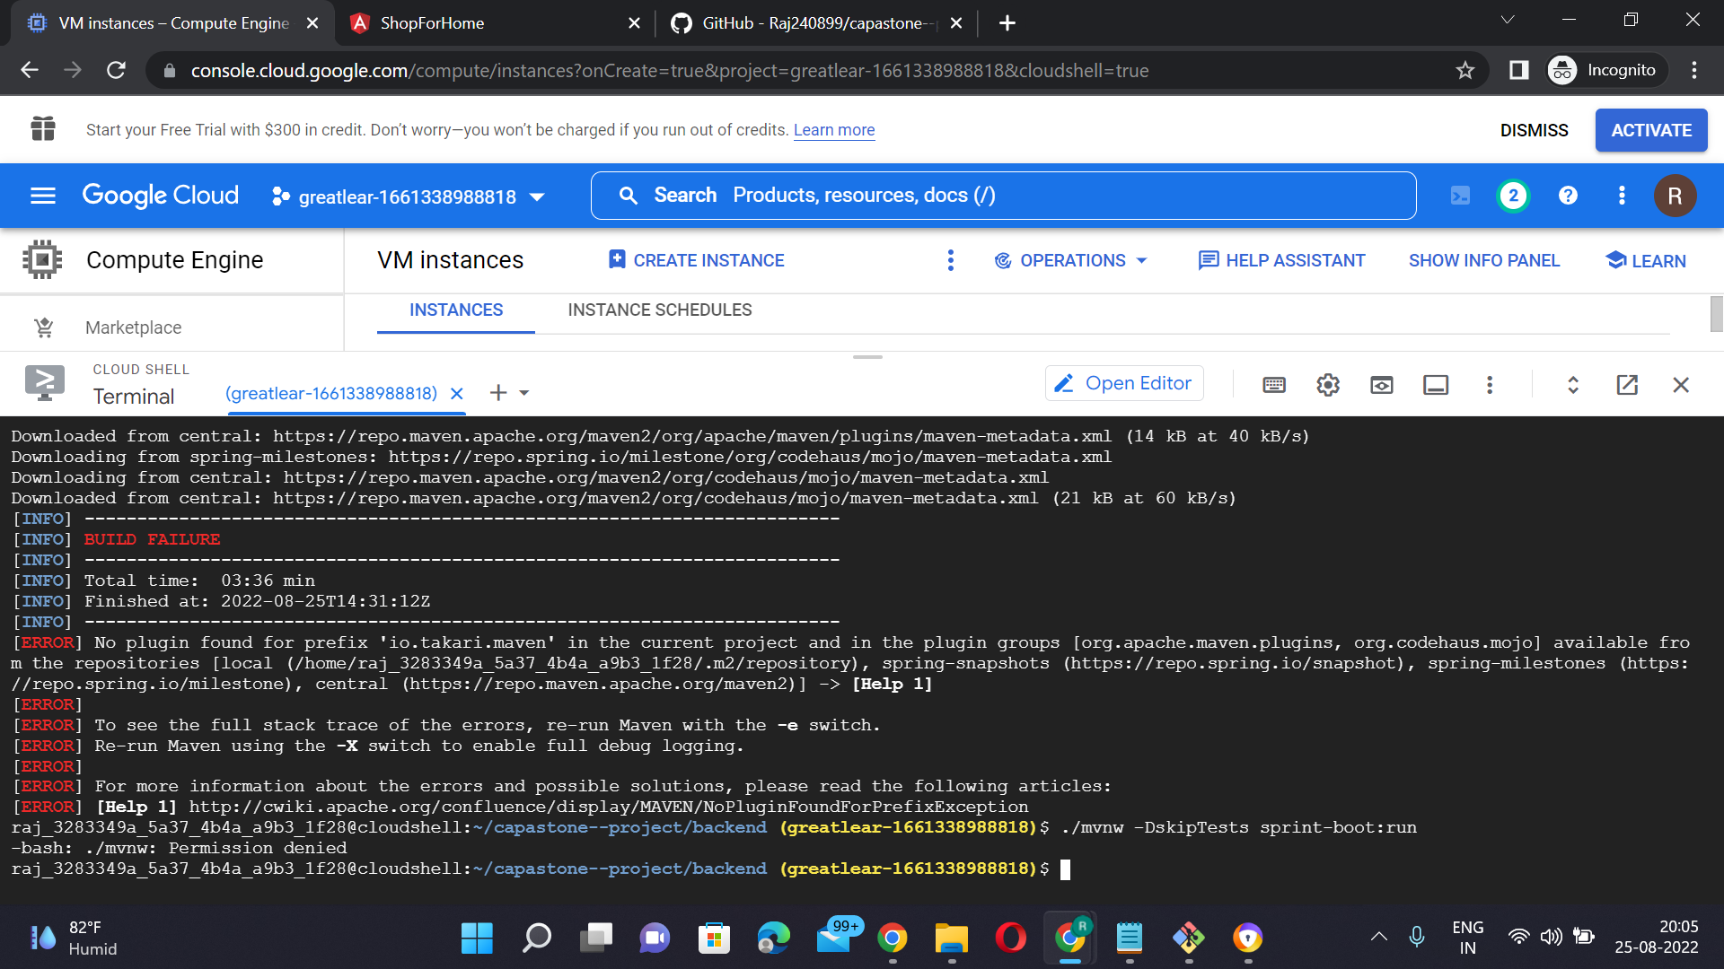
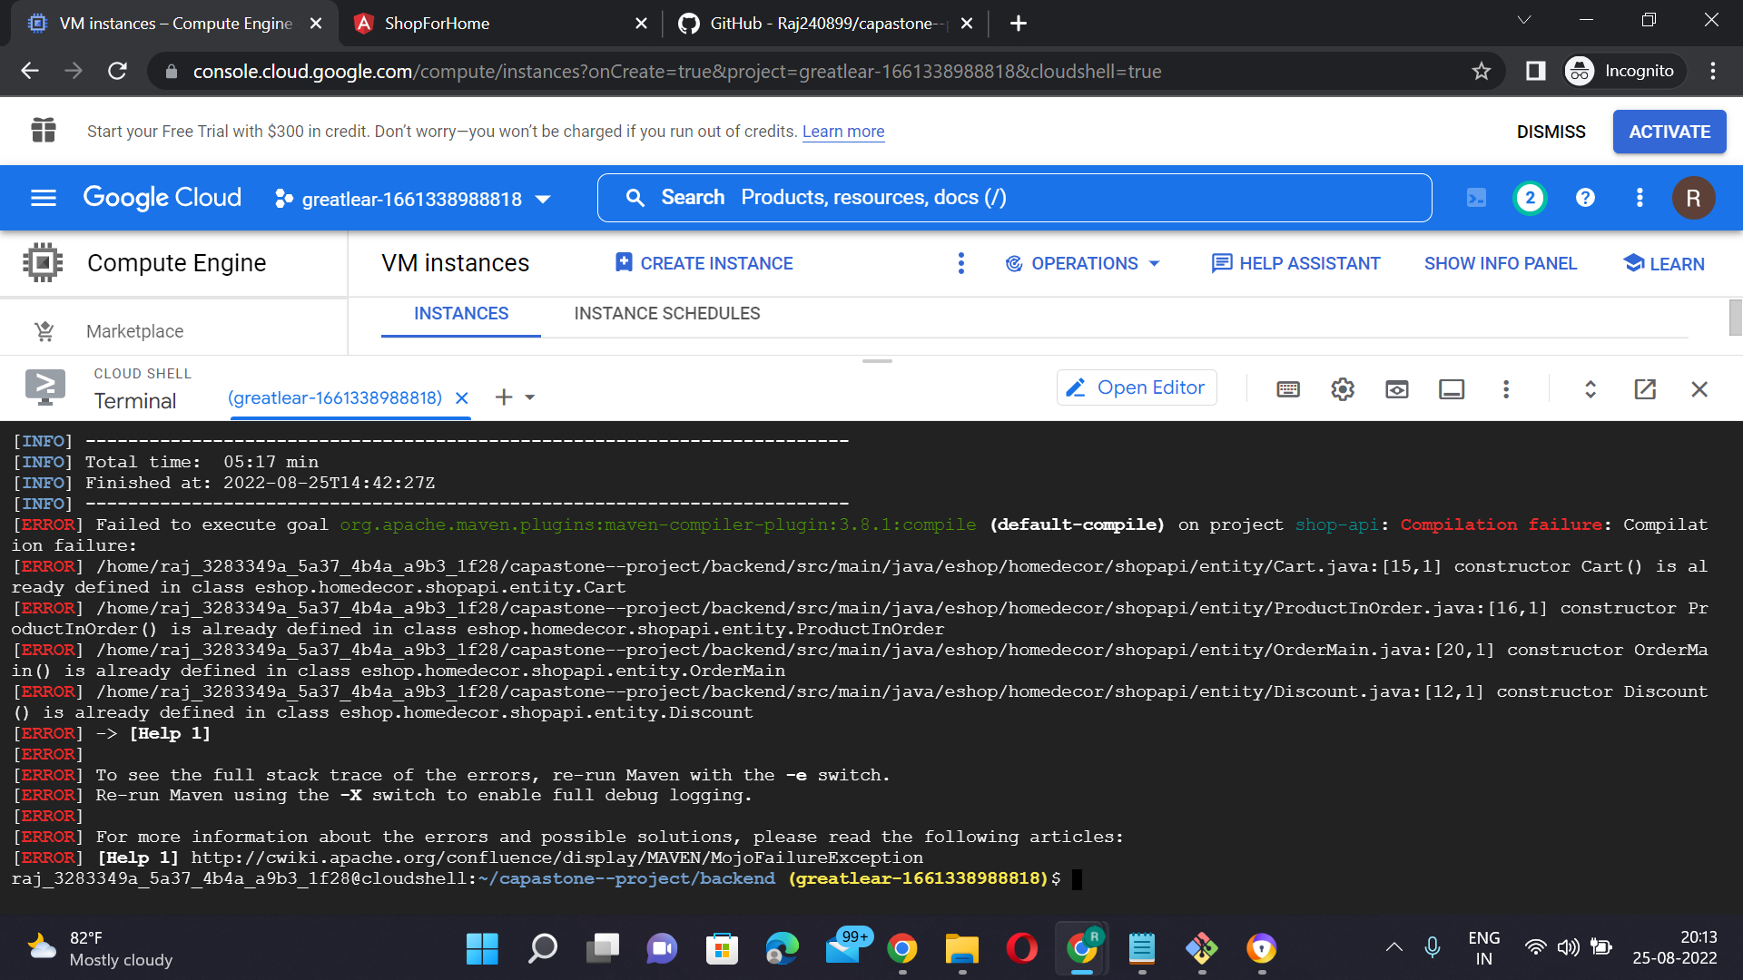

Slide 17
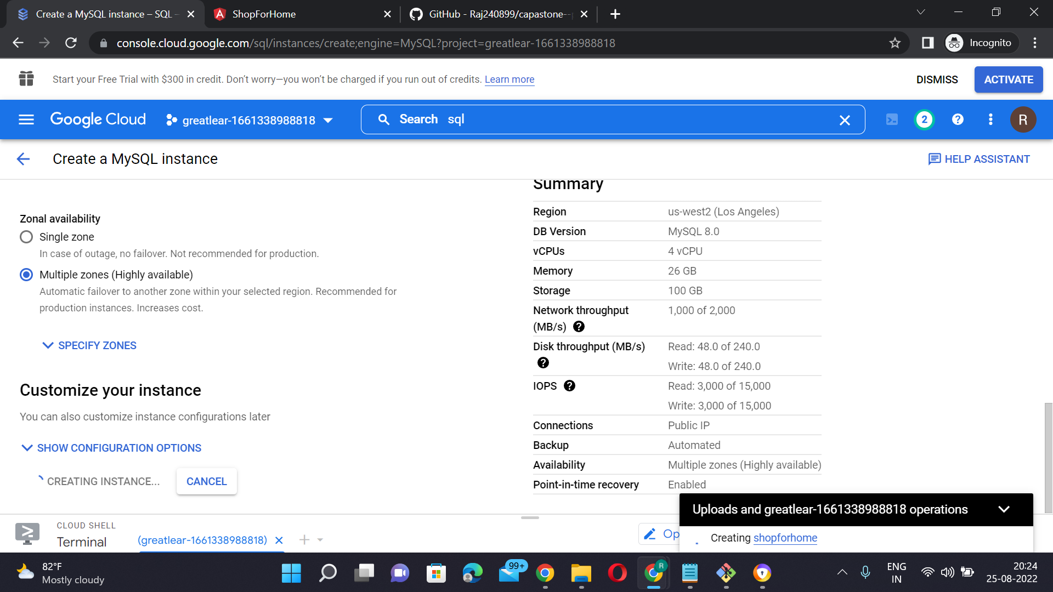
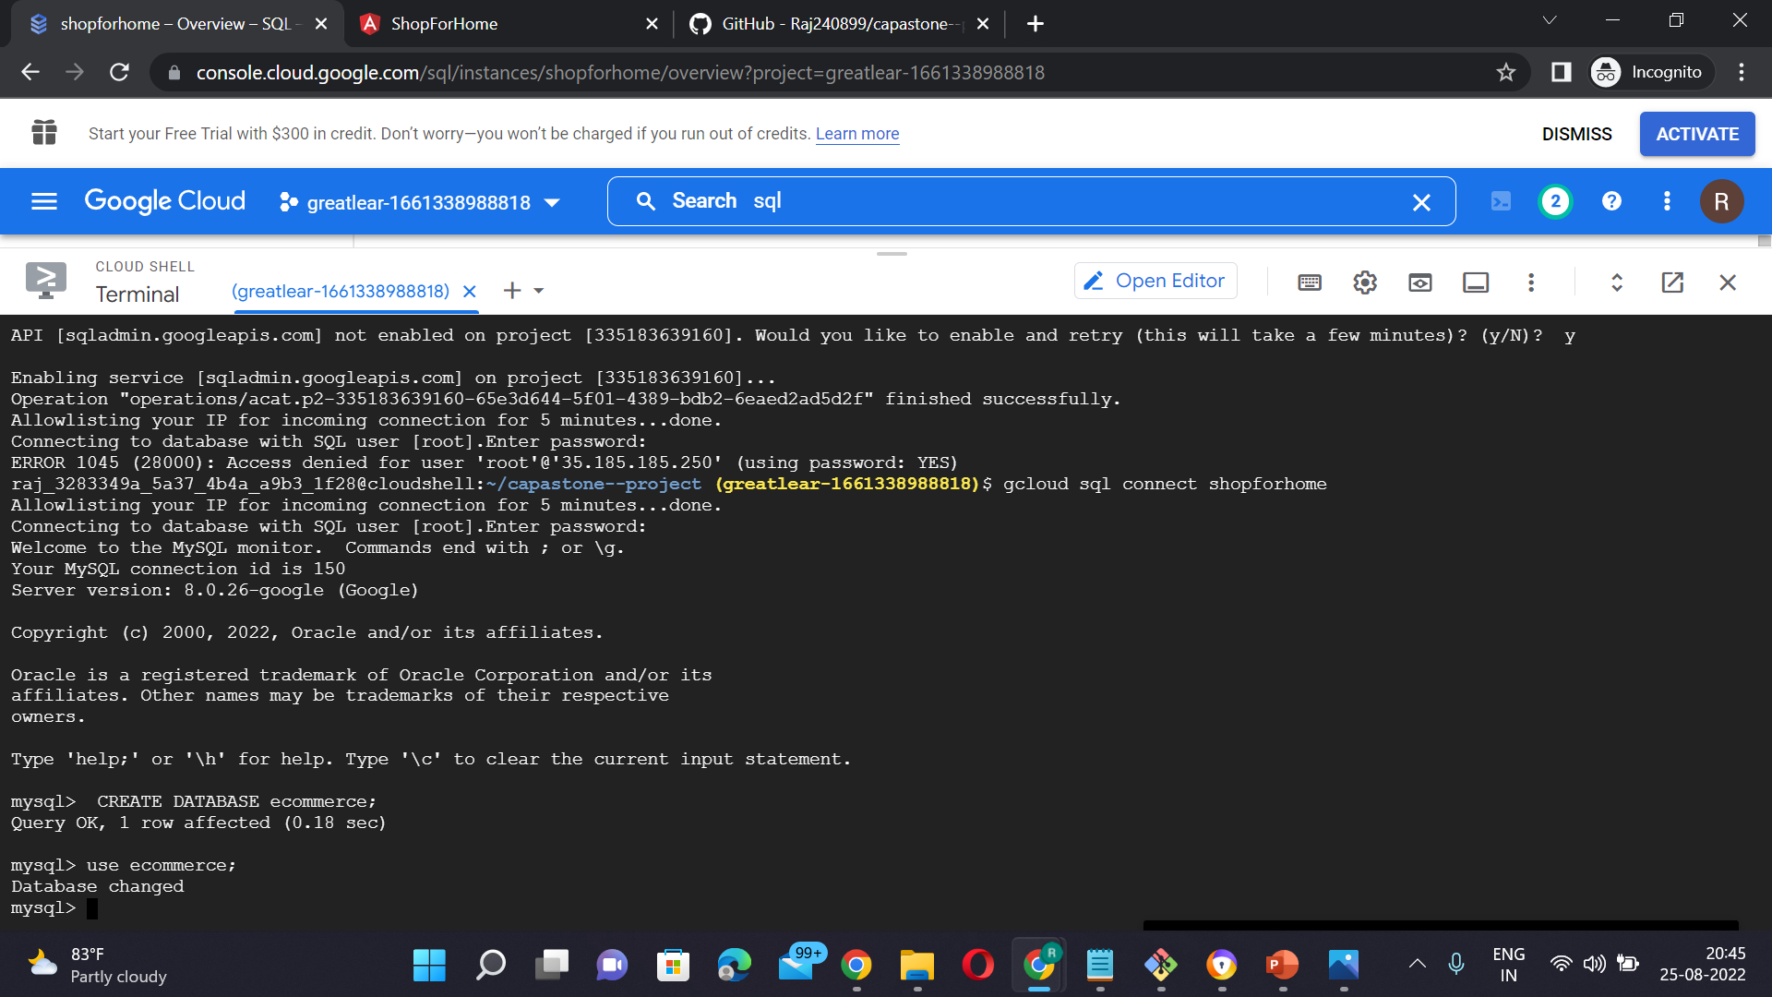
DATABASE PART

Slide 18
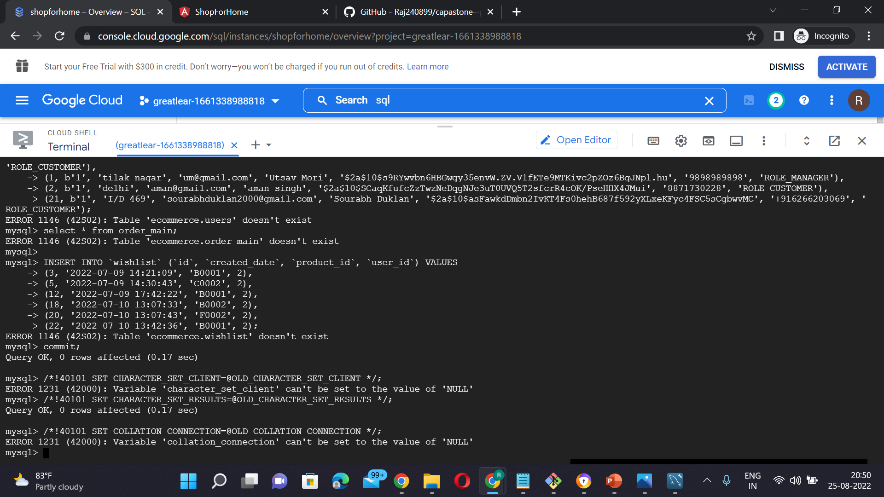

Slide 19

Thank you

